Slide 1
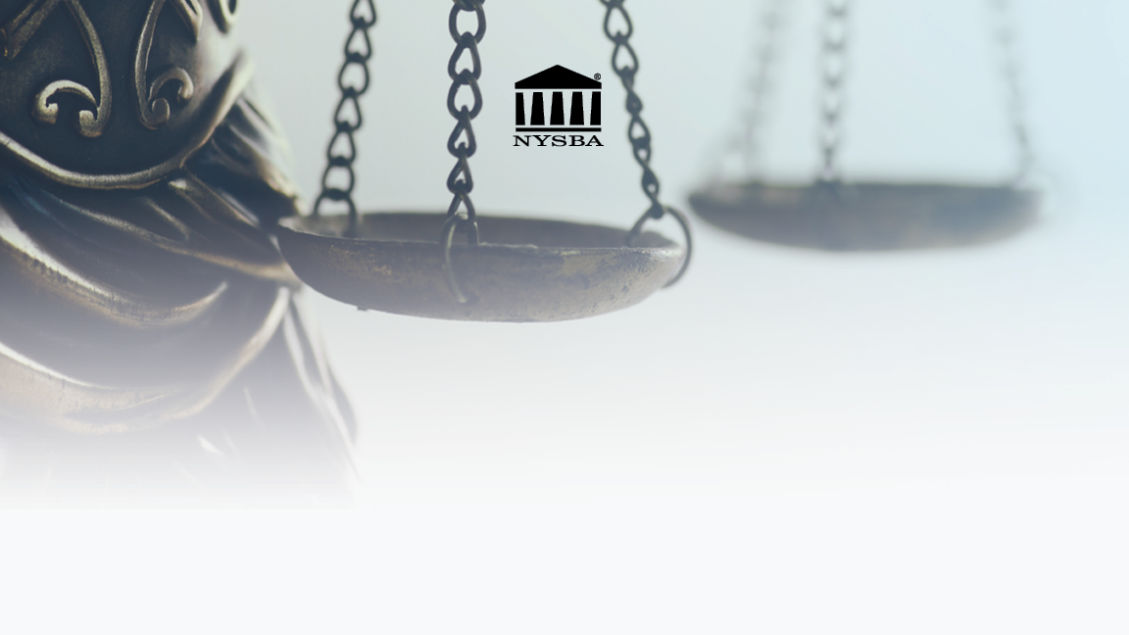
Report of Task Force on Racism, Social Equity and the Law
Taa Grays and Lillian Moy
Task Force Co-Chairs
January 2023

Slide 2
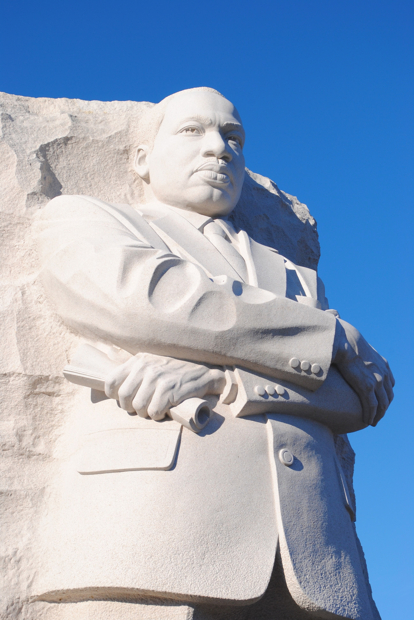
“We may have all come on different ships, but we're in the same boat now.” Dr. Martin Luther King, Jr.

Slide 3
Agenda
Work of the Task Force
Why Support the Task Force Recommendations?
Q&A

Slide 4
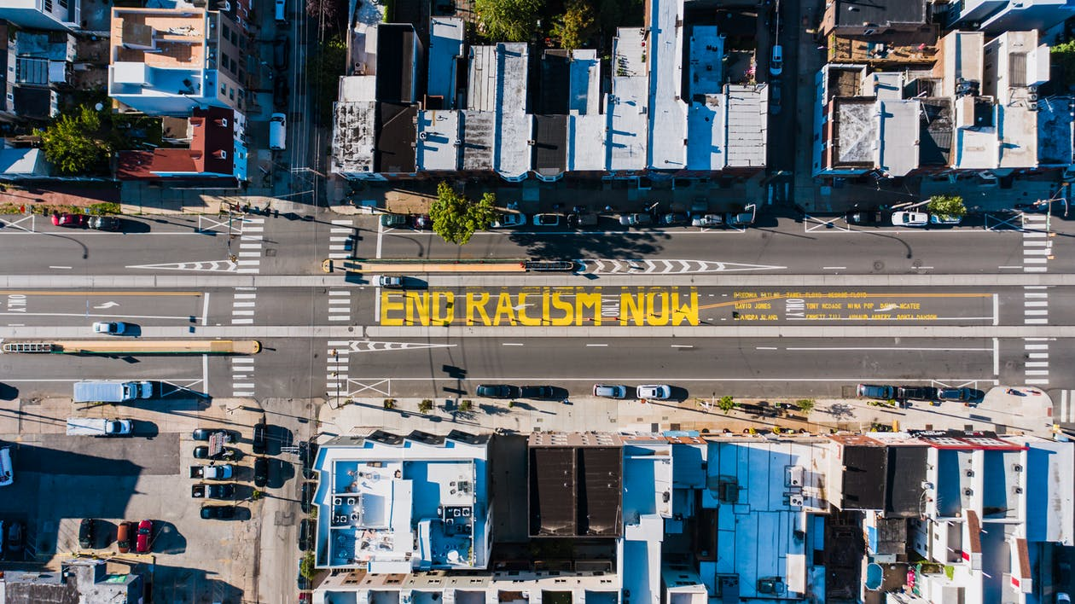
In Pursuit of Justice – the Association’s Purpose
Grounded in the Association’s purposes outlined in our By-Laws:
Promote reform in the law
Facilitate the administration of justice
Apply its knowledge and experience in the field of the law to promote the public good

Slide 5
In Pursuit of Justice – Task Force Mission
examine how structural racism permeates and influences facets of daily life leading to injustice and inequality among New Yorkers
include six committees that will examine the key issues that cause structural racism to be entrenched and persistent
through its committees explore changes in the law and public policy and deliver a report recommending action steps the NYSBA can take to attack structural racism and effectuate meaningful societal transformation

Slide 6
In Pursuit of Justice – Areas of Focus
Housing
Environmental Justice
Health
Criminal Justice
Education
Economic Opportunity

Slide 7
In Pursuit of Justice – Dismantling Structural Racism
“Structural racism is a system of laws, policies and institutional practices that produce and perpetuate racial inequities and inequality in this state.” - Professor Paula Johnson

Slide 8
In Pursuit of Justice – Work of Task Force
June 2022 – September 2022
Reviewed the feedback:
How are the recommendations connected to NY?
September 2022 – November 2022
Drafted a history section
Reduced the number of recommendations from 40 - 13
December 2022 – January 2023
Held two informational sessions
Discussed recommendations with specific sections
Restructured report
June 2021 - June 2022
Established Task Force specific mission
Built Task Force Team and Committees
Researched issued: held 4 public forums, reviewed legal decisions and public policy, interviewed numerous experts
Drafted Report
Circulated for Feedback
Held Informational sessions
How are the recommendations connected to each other?
What meaningful action can the Association actually take?
There are too many recommendations.
Specific feedback on the feasibility of specific recommendations.
Focused on recommendations that were the most impactful.
Focused on recommendations that the Association could effect.
Prepared to respond to issues raised

Slide 9
Why Support the Recommendations?
New York history shows that its laws, policies and practices created racial inequities and inequality.
These inequities and inequality became embedded in how institutions functioned to the detriment of communities of color.
Current data shows that the impact of the racial inequities and inequality of these laws, policies and practices continues to be felt.
The recommendations are tailored to address issues that will mitigate these inequities and inequality.
The recommendations are within the purview of the Association’s work.

Slide 10
Structural Racism Exists in New York
Slavery
(1626 – 1827)
Under the Color of Law
(1827 – 1937)
The Civil Rights Fight
(1938 – 1964)
Current Conditions
(1964 – present)

Slide 11
Recommendations are Tailored to Address Issues
Measure the Problem
Gather data
Measure impact of bias in Health, Education, Criminal Justice
Training Professionals
Implicit Bias Training
Raise Awareness and Prevent Bias in Health, Education, Housing
Gather further facts and discuss remedies
Create Commissions
Wealth Gap – causes behind it and remedies to address
New/Modify laws and rules
Increased accountability in following regulations
Equitable Education Funding – data to ensure obligation is met
New procedures for juries
Childcare
Minimize disproportionate discipline in schools
Funding Recommendations
Access to capital for MWBEs
Landlord accountability for eliminating lead in water
Government agencies audited to ensure following environmental regs

Slide 12
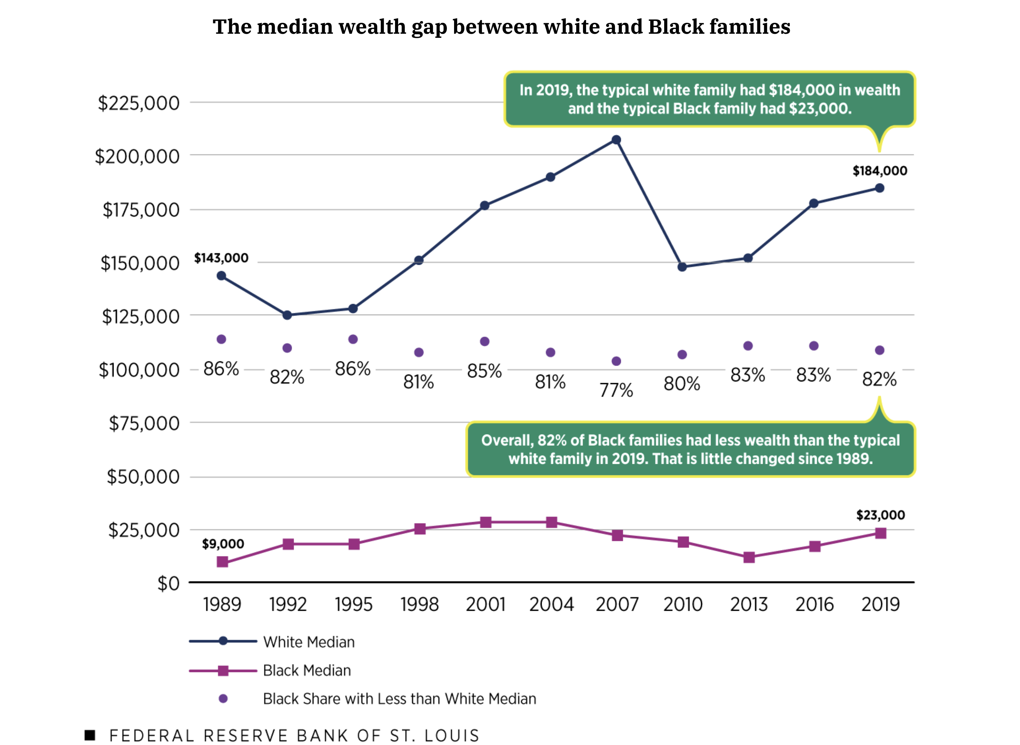
Recommendations are Tailored to Address Issues
Recommendation: Creation of a Wealth Gap Commission
A group of citizens were harmed economically: not compensated for their labor, denied economic opportunities, denied educational opportunities, provided limited housing opportunities.
This harm has created a wealth gap that continues to persist.
A Commission to study the Wealth Gap will analyze this economic harm and recommend legal changes to minimize the gap
Similar to the Association’s work on marriage equality: studied origins and impact of lack of equality, concluded legal change was necessary, the Association advocated for legal change needed to correct the civil rights issue.

Slide 13
Recommendations are Tailored to Address Issues
Recommendation: Minimize Disparate Educational Outcomes - Commission
The establishment of an independent commission to address equitable funding is necessary
The Court itself has indicated that it will not be the forum in which the factual determinations about equitable funding will be hammered out.
Provide the factual underpinning for continuing implementation of the decisions of the Court of Appeals in Campaign for Fiscal Equity v. New York.

Slide 14
Within the purview of the Association: Fulfill NYSBA’s Purpose to Pursue Justice
Committees had practitioners in the areas
Committees spoke to experts in the areas
Policy leads to the creation of law; law influences policy creation or enforcement
Government agencies set and implement policy through statutes and regulations
Litigation can be used to implement policies that exist but are not being enforced.
Recommendations are based on our collective knowledge and experience of the confluence of law and policy
We should not shrink from controversy on issues affecting the profession and the administration of justice.*
* Report on Special Committee on Legislative Advocacy, January 2002, page 11.

Slide 16
