Slide 1
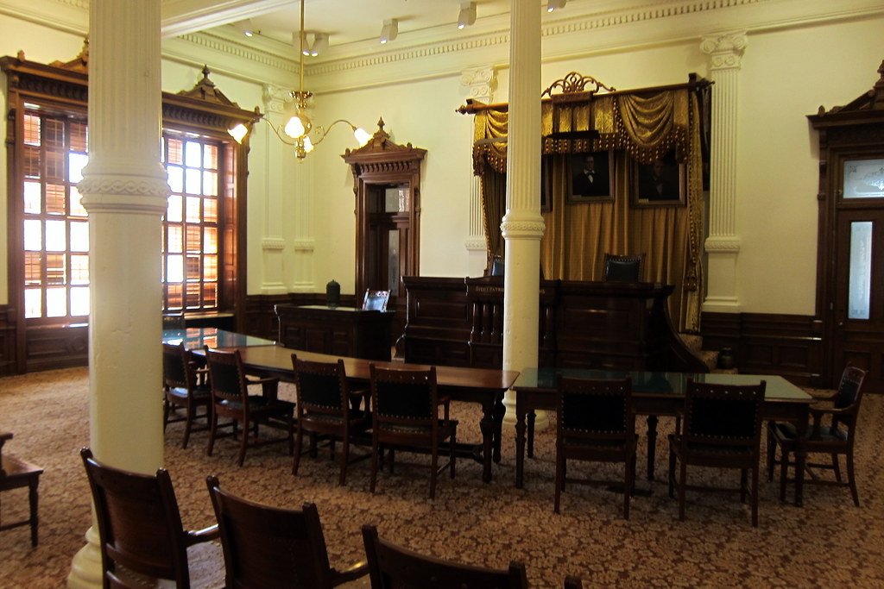
Stay on Trend
Key Issues Impacting Local Bar Associations

Slide 2

Statistical Snapshot of Local Bars
Notes:
TBD

Slide 3
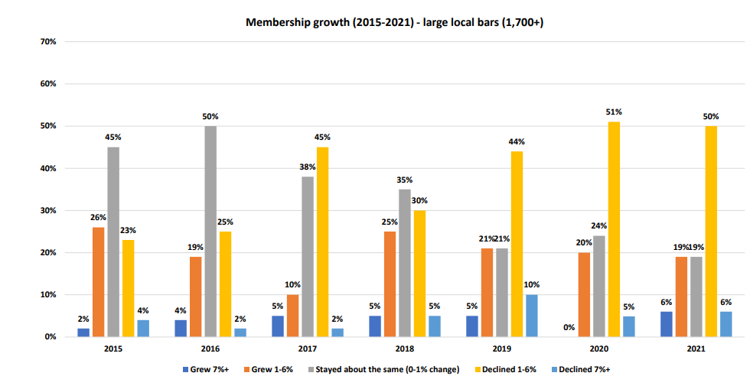
Large Local Bar Membership Growth 2015-2021

Slide 4
Hot off the presses- New data on local voluntary associations!
Membership rates grew by 3.28%
Retention Rate: 94%/Market Rate: 50.2%
Percentage of Members Over 65: 22.9%
Percentage of Members 35 and Under: 18.7

Slide 5
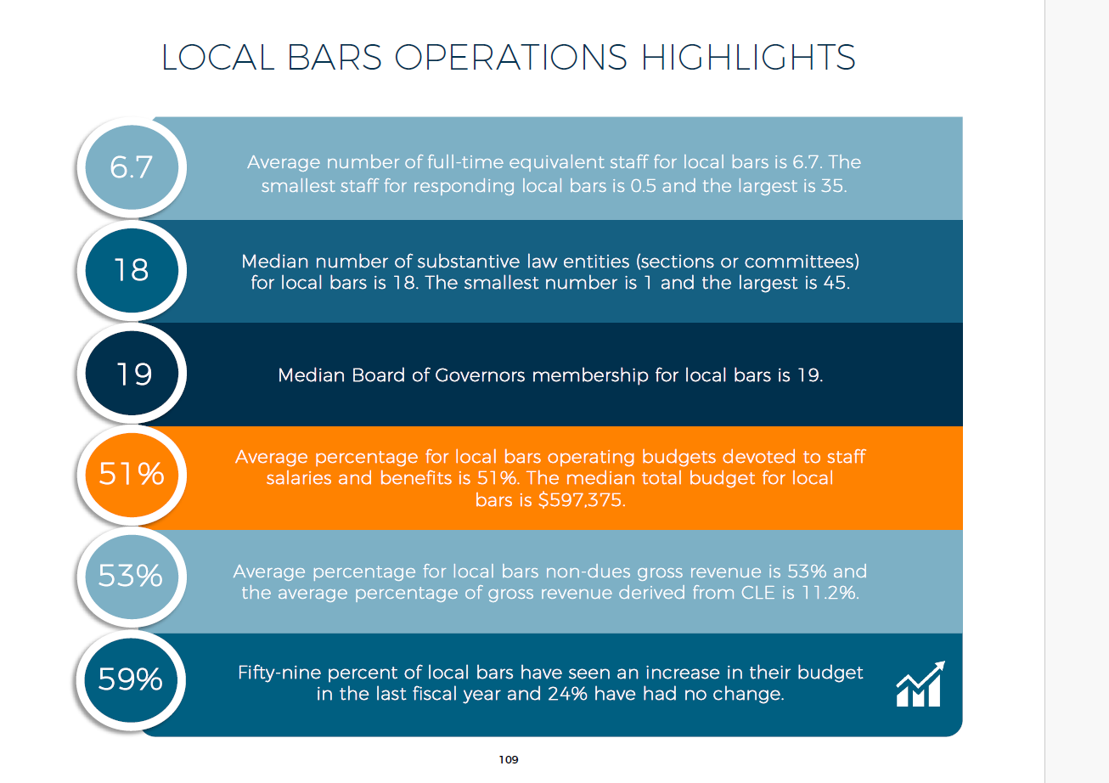

Slide 6

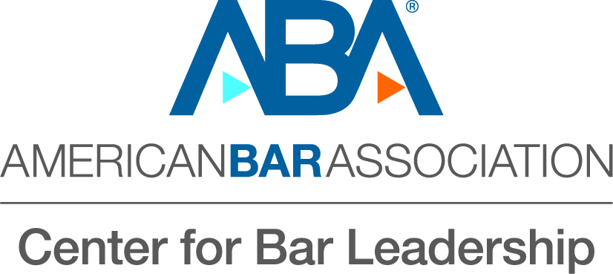
Lessons from Bowling Alone
Social structures—whether they be PTA, local organizations, church, etc. help create a society that is happy, healthy, and safe.
How does the decline of those structures impact us and our institutions?
Notes:
Published in 2000
Precient

Slide 7
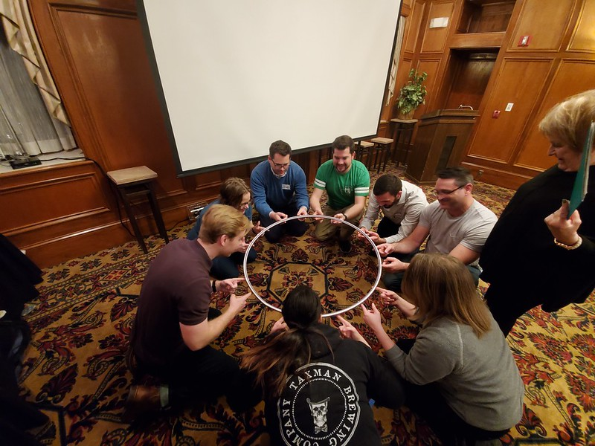
Grab an Oar: It’s Time to Collaborate

Slide 8
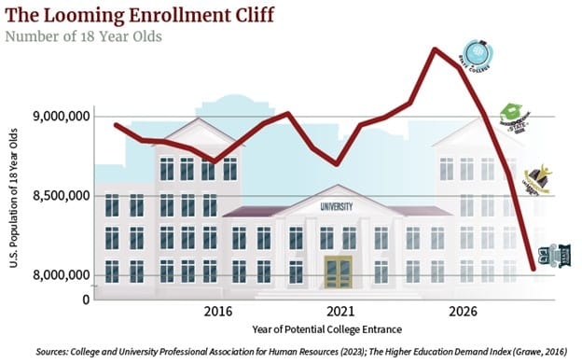
Demographic Cliff: Declining Numbers of Potential Attorneys

Slide 9

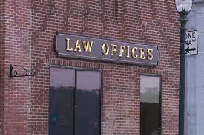

Future of the Legal Workforce/ Urbanization of the Profession

Slide 10

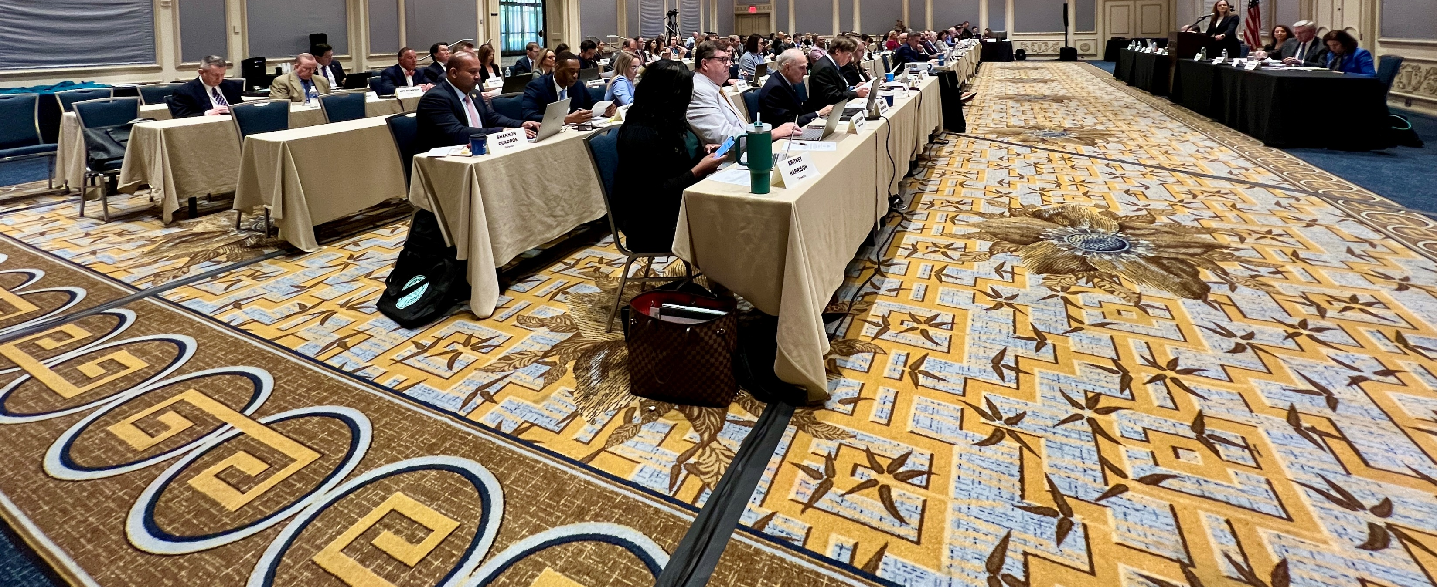
AI’s Impact on the Legal Profession

Slide 11
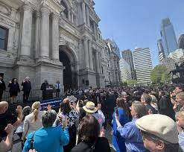
Rule of law and access to justice issues and their impact on the bar

Slide 12
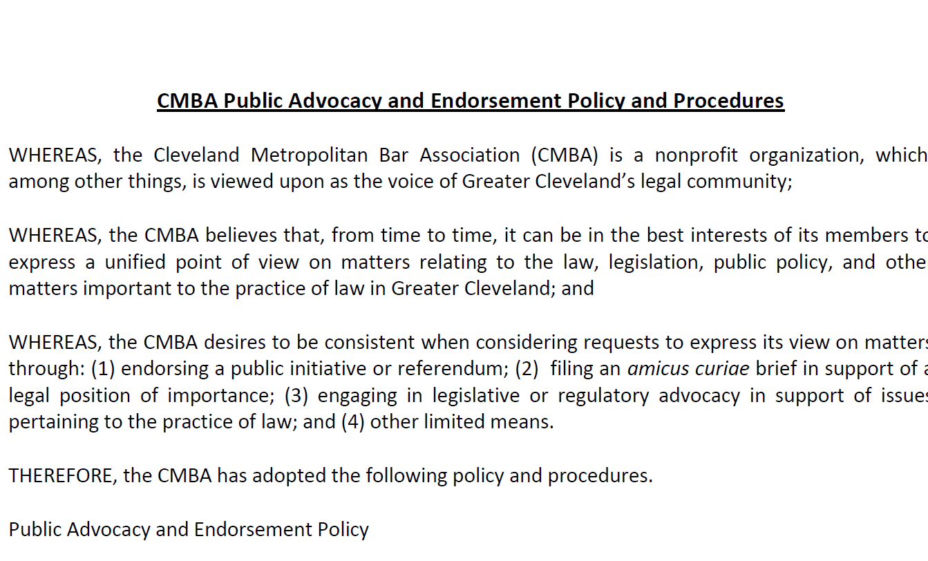
Understanding Your Bar’s Culture & Developing Policies Around It

Slide 13
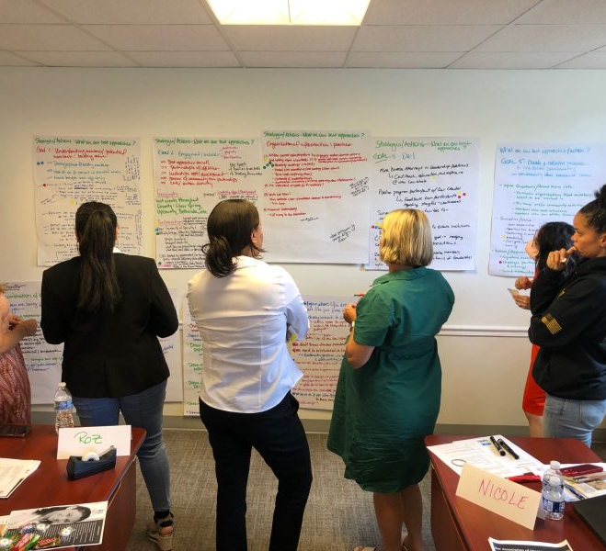

Governance Challenges

Slide 14

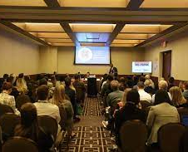
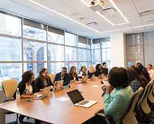
Meeting Angst

Slide 15
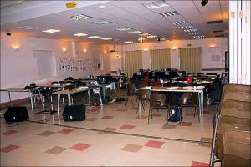
Member engagement issues post-COVID

Slide 16
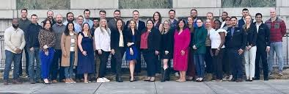
New Approaches to New Lawyers

Slide 17
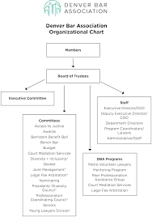
Staffing Sustainabilty

Slide 18

The Need for Better Storytelling

Slide 19

Any questions: contact me!
Molly.Flood@americanbar.org

