Slide 1

Trends Update
Mass Bar Association
October 8, 2025

Slide 2



Big Picture
Data
Notes:
TBD

Slide 3
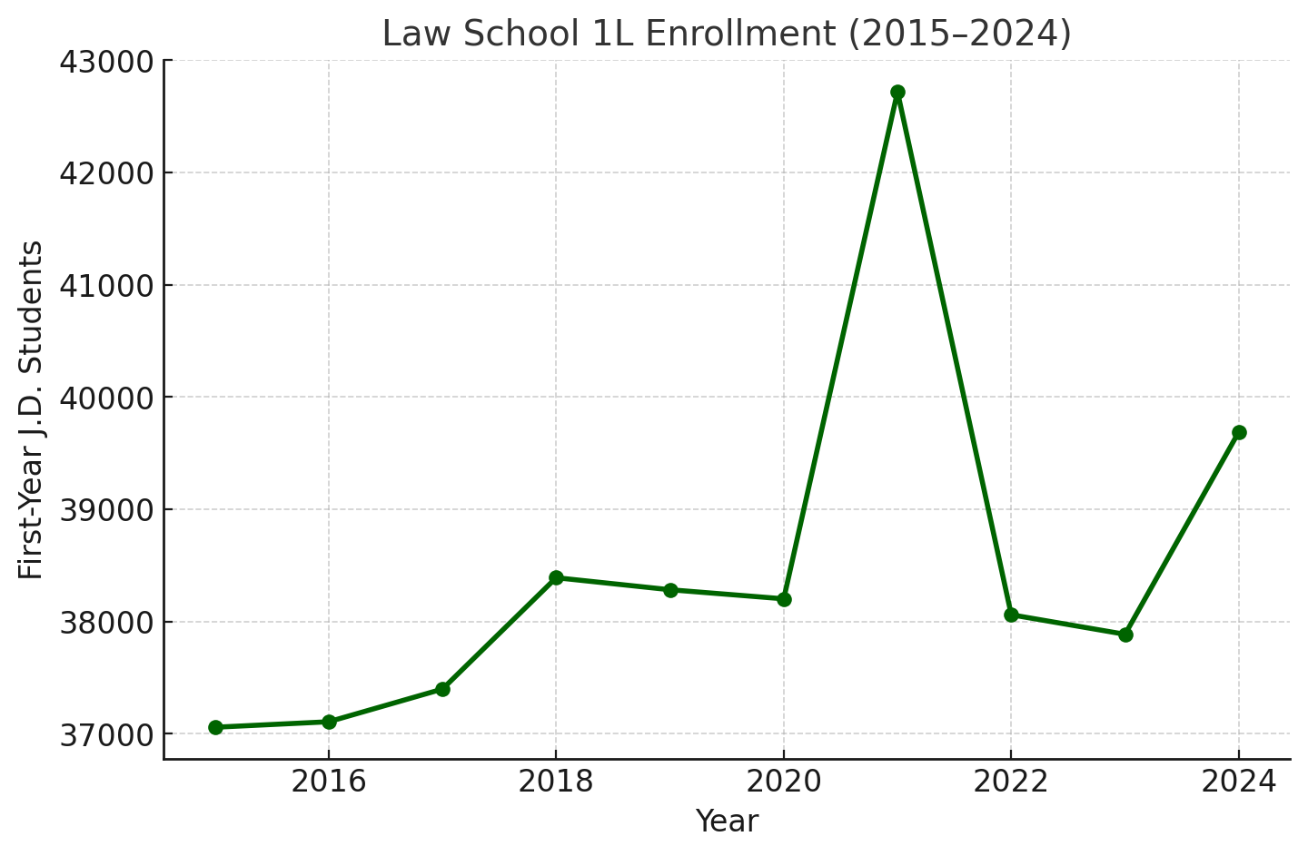
Trends in Law School Enrollment
COVID
Key Insights:
• Enrollment bottomed around 37k (2015–2017).
• Stabilized near 38k through 2020.
• 2021 saw a major spike to 42.7k.
• Numbers dipped in 2022–23, rebounded in 2024 (~39.7k).
2025 Law School Applications and Enrollments
Notes:
Note the political environment. Liberty University.

Slide 4
U.S. Lawyer Population (2015–2024)
Based on ABA National Lawyer Population Survey and related reports

Slide 5
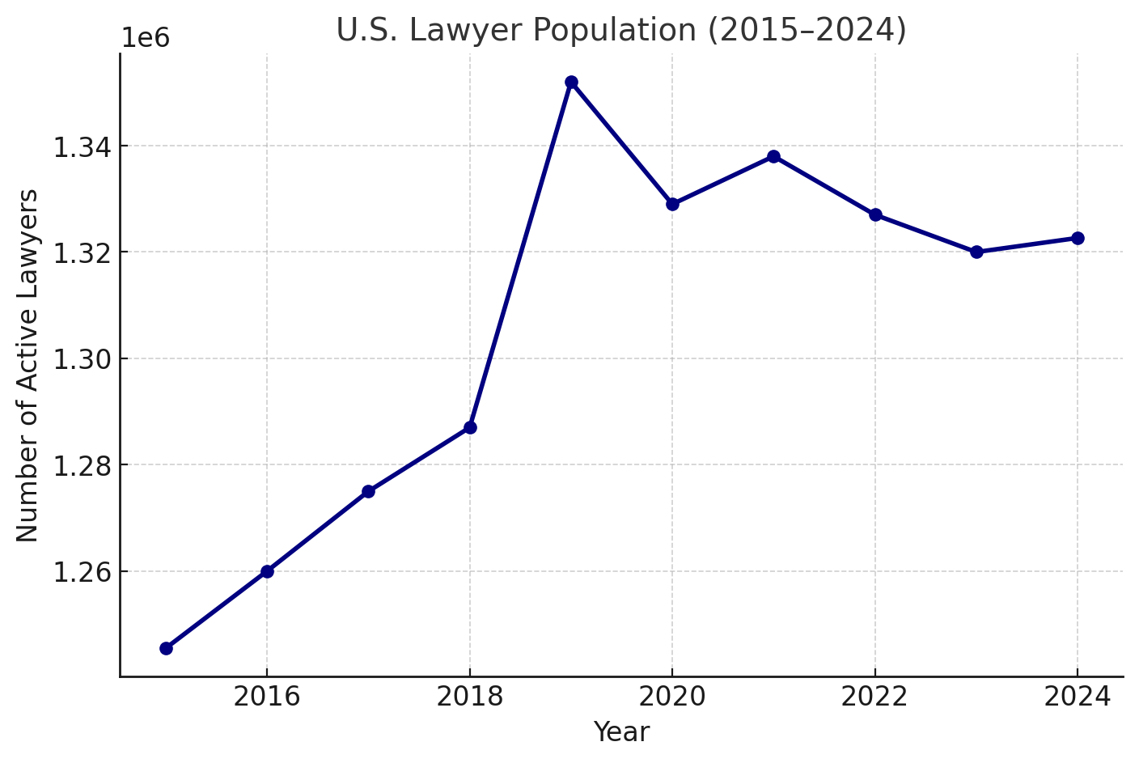
Trend in Lawyer Population
Key Insights:
• Slow but steady growth since 2015 (~1.25M → 1.32M+).
• 2019 showed a spike above 1.35M.
• Pandemic years saw small dips but profession stabilized.
• Overall: about 7% growth in 10 years.

Slide 6
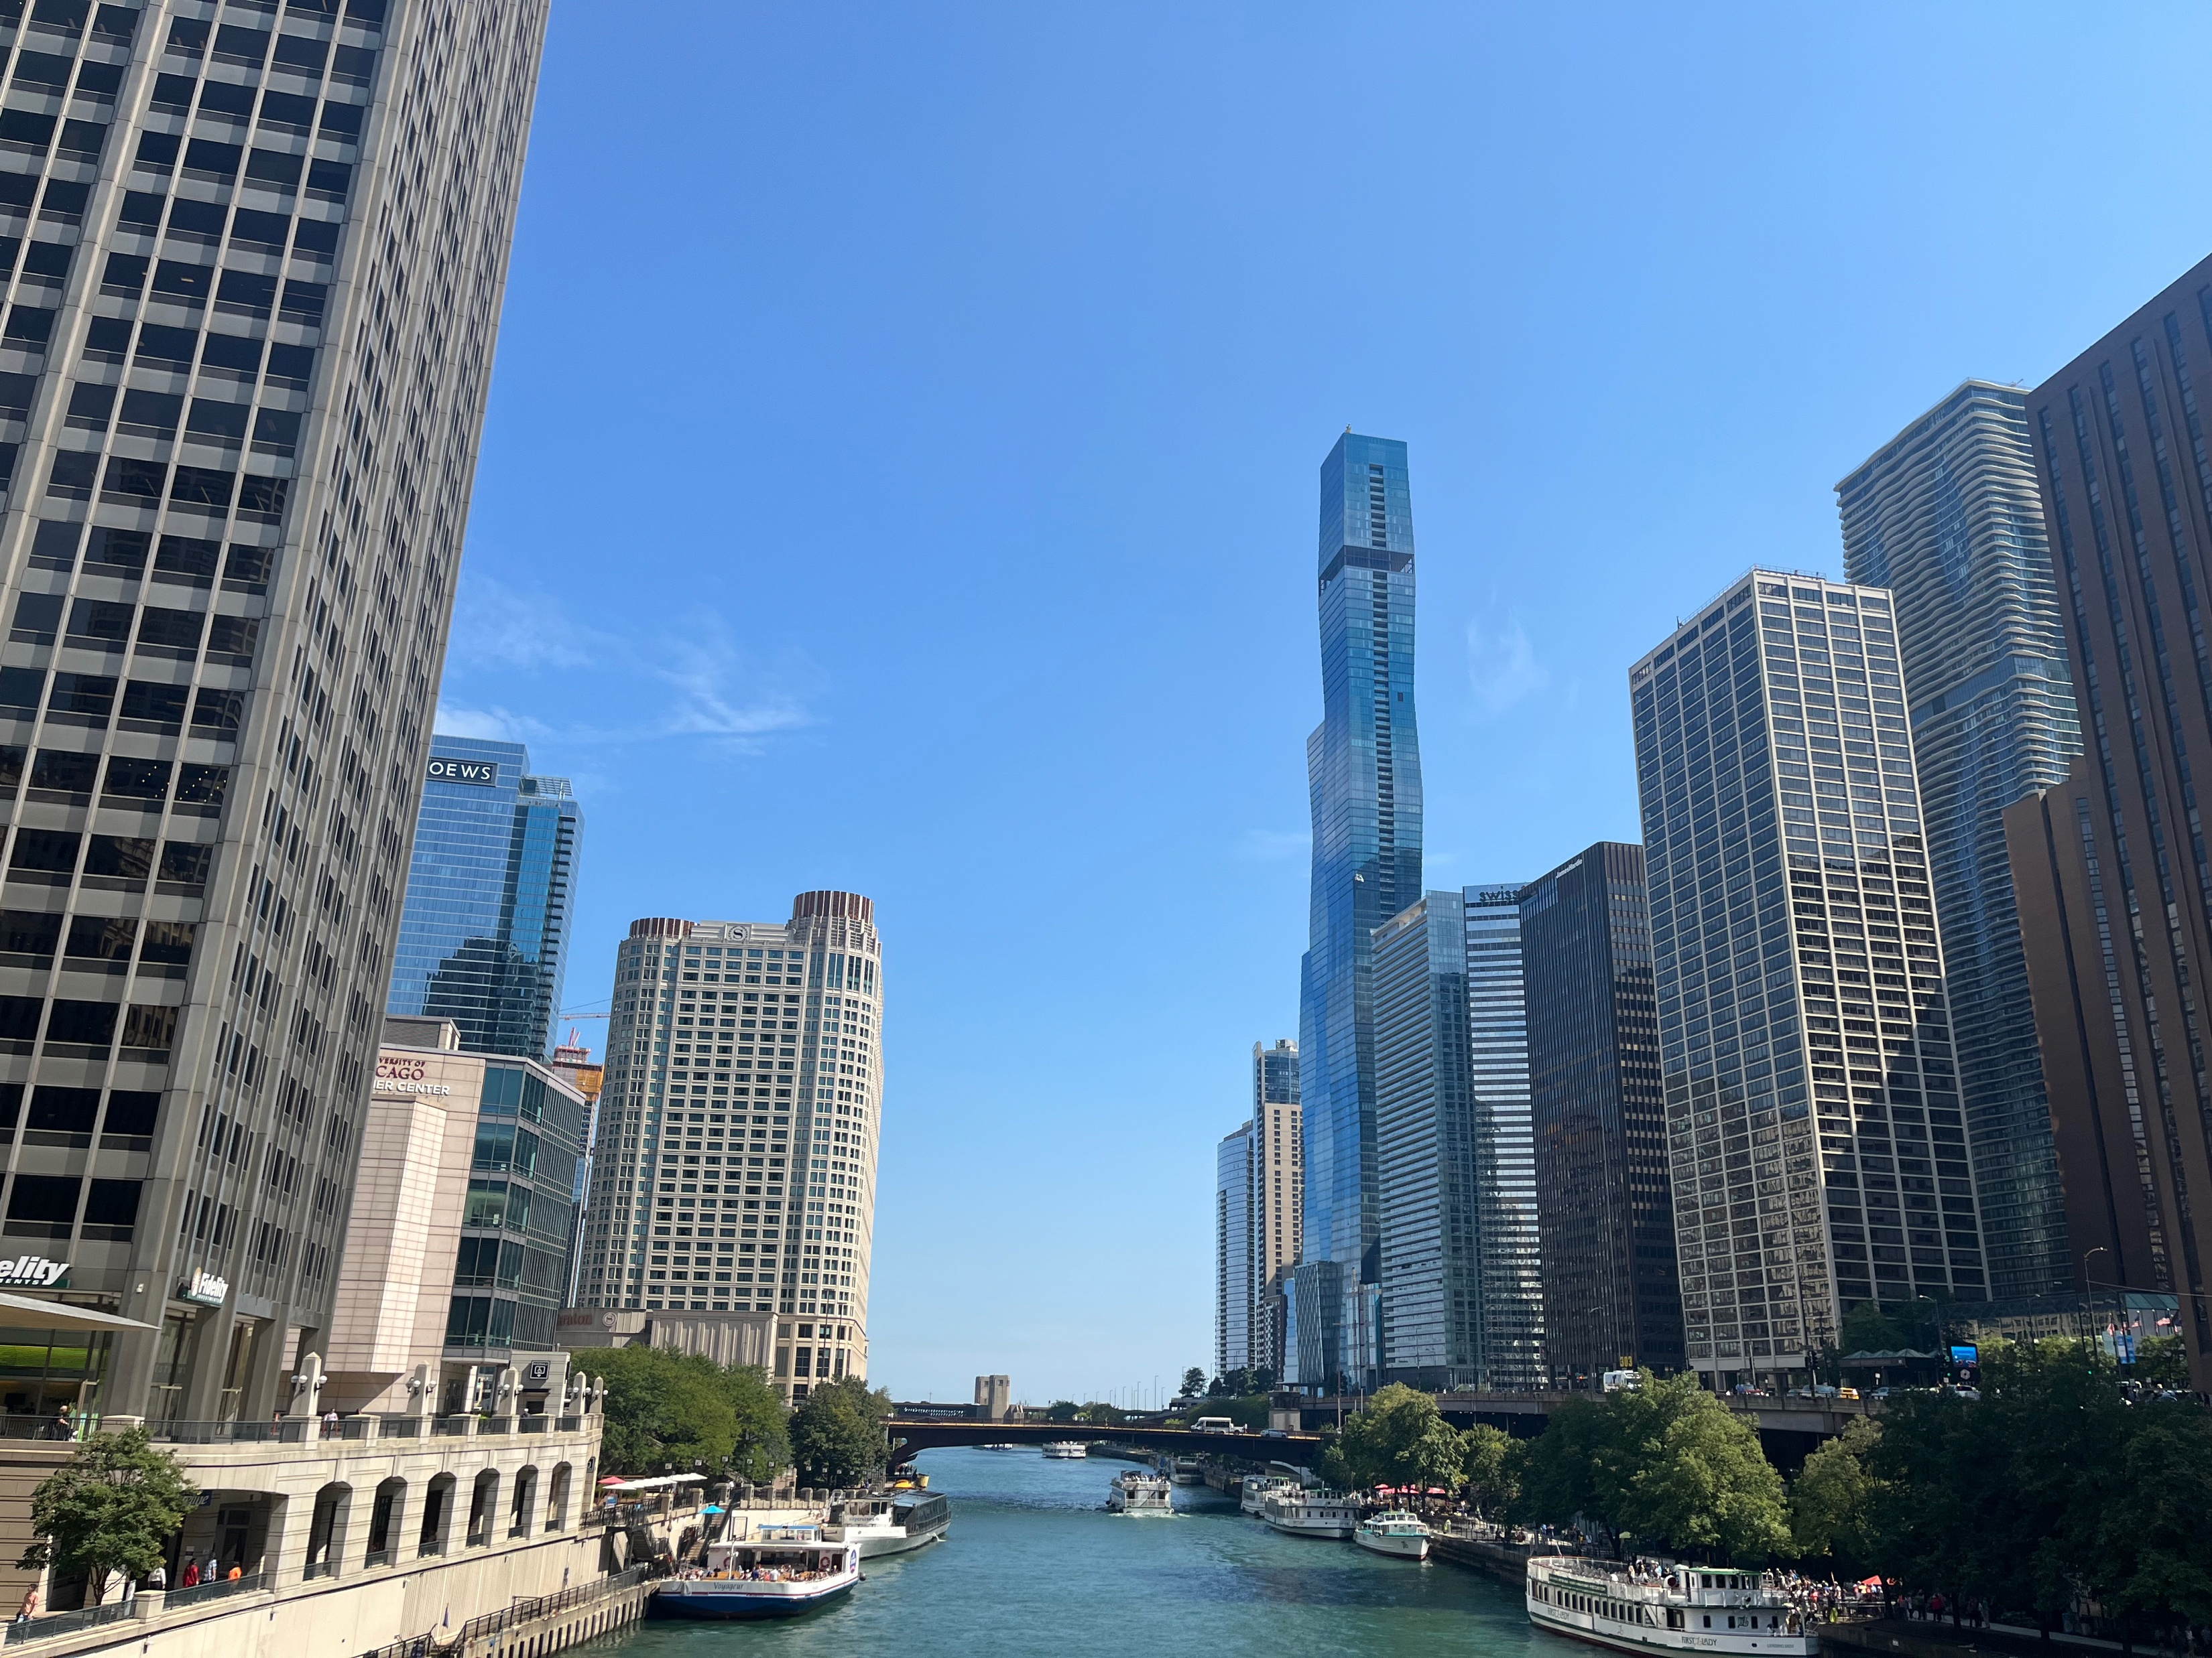

Urban versus Rural Divide

Slide 7
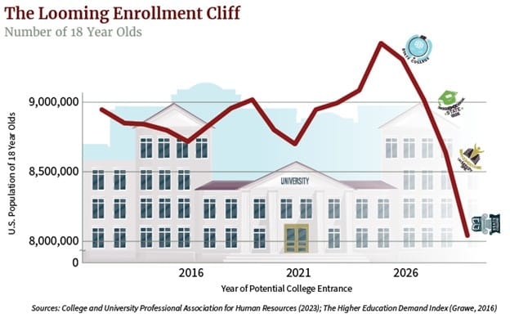
Demographic Cliff: Declining Numbers of Potential Attorneys

Slide 8
Changes to the Student Loan Program
Potentially Impactful
Lower Caps on Some Loans
Changes to Pell Grants
Private Borrowing Market = Higher Debt Levels
Public Service Loan Forgiveness restriction
Public Service
Fewer students from underrepresented groups (rural, first generation to go to college, lower income families)
Affordability
IMPACT

Slide 9
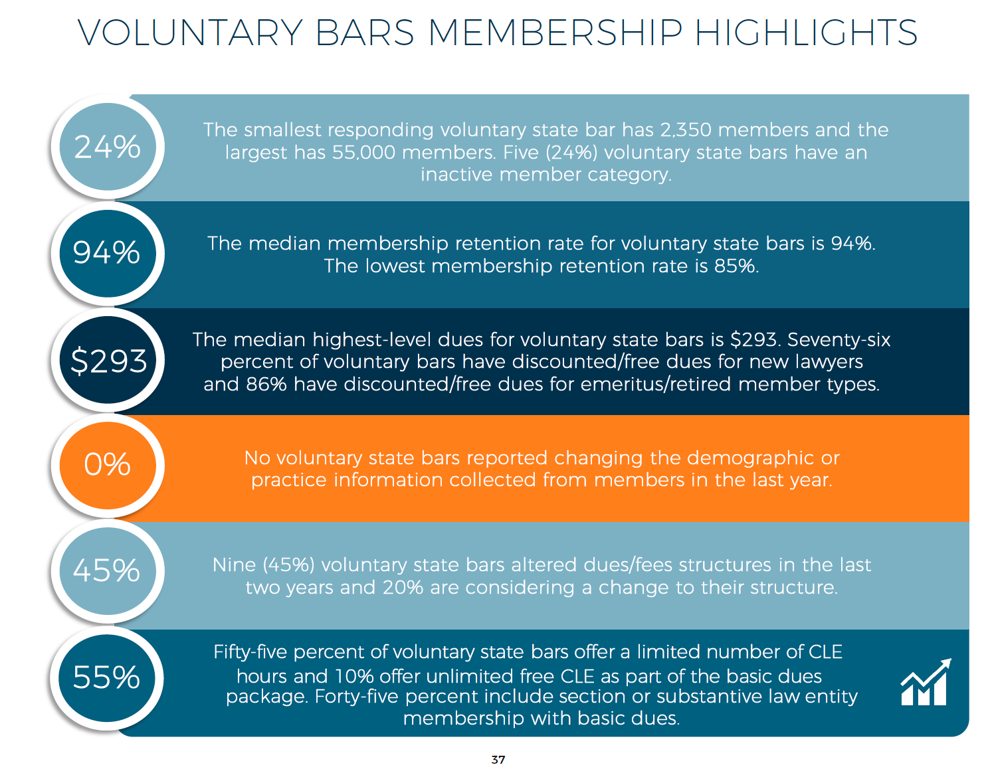

Slide 10
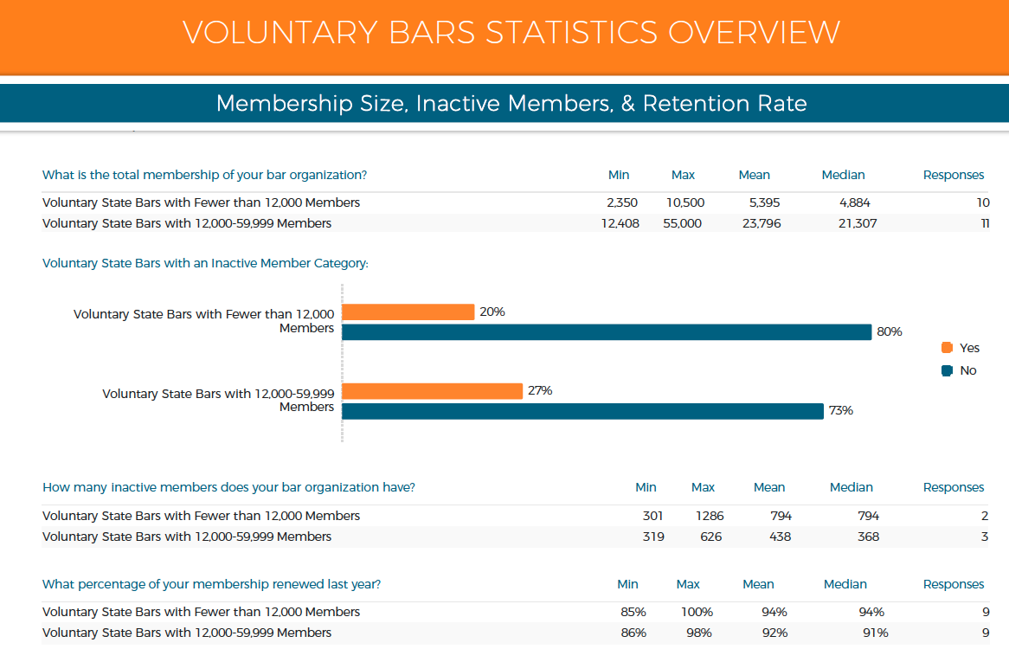

Slide 11
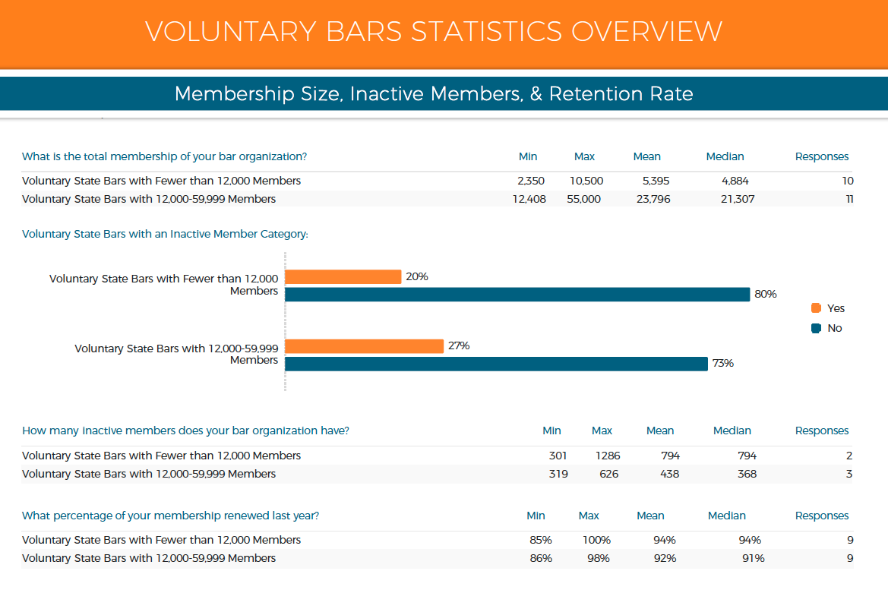

Slide 12
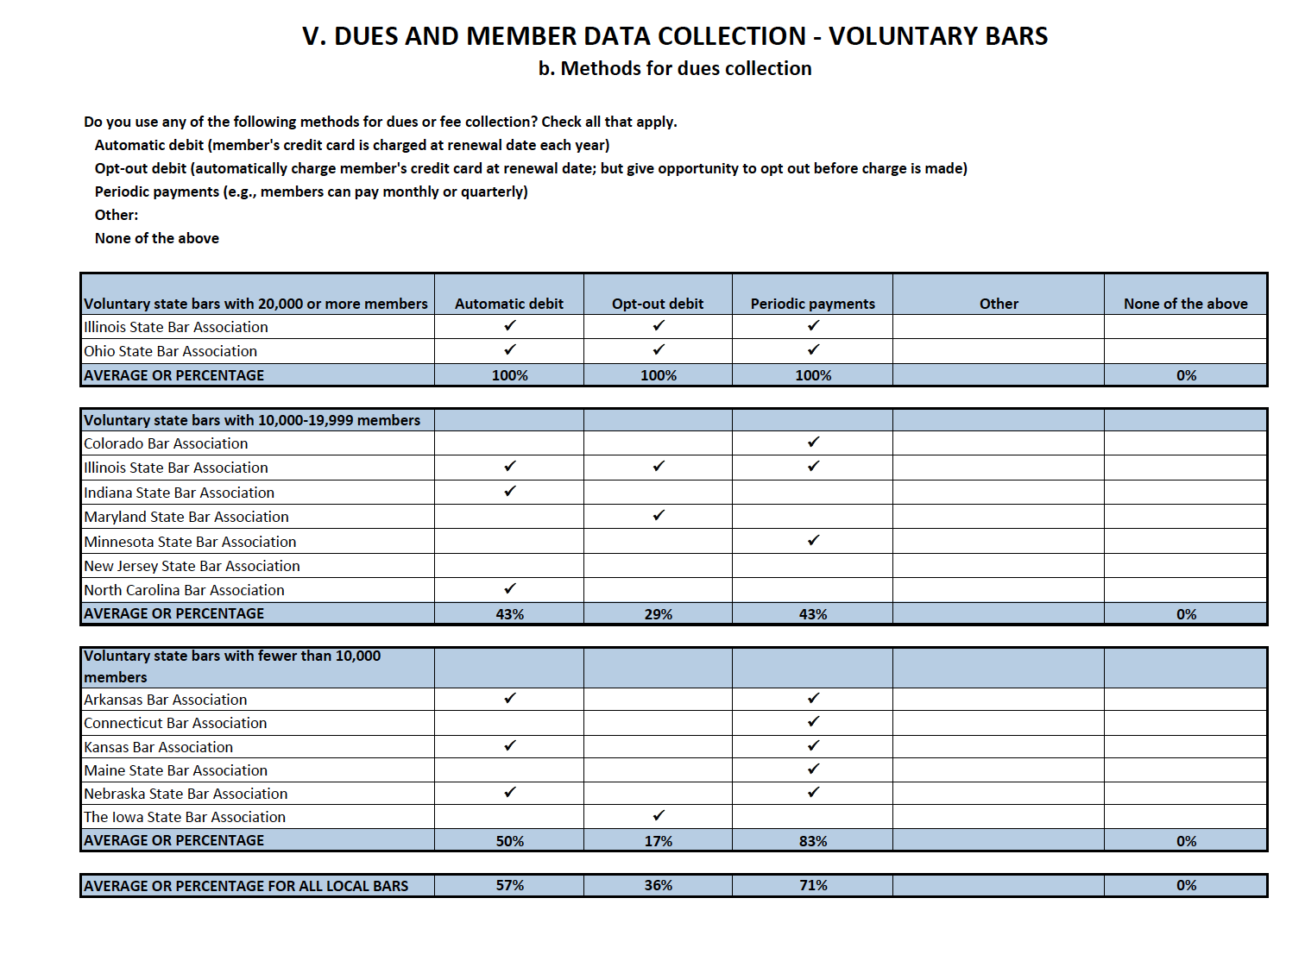

Slide 13
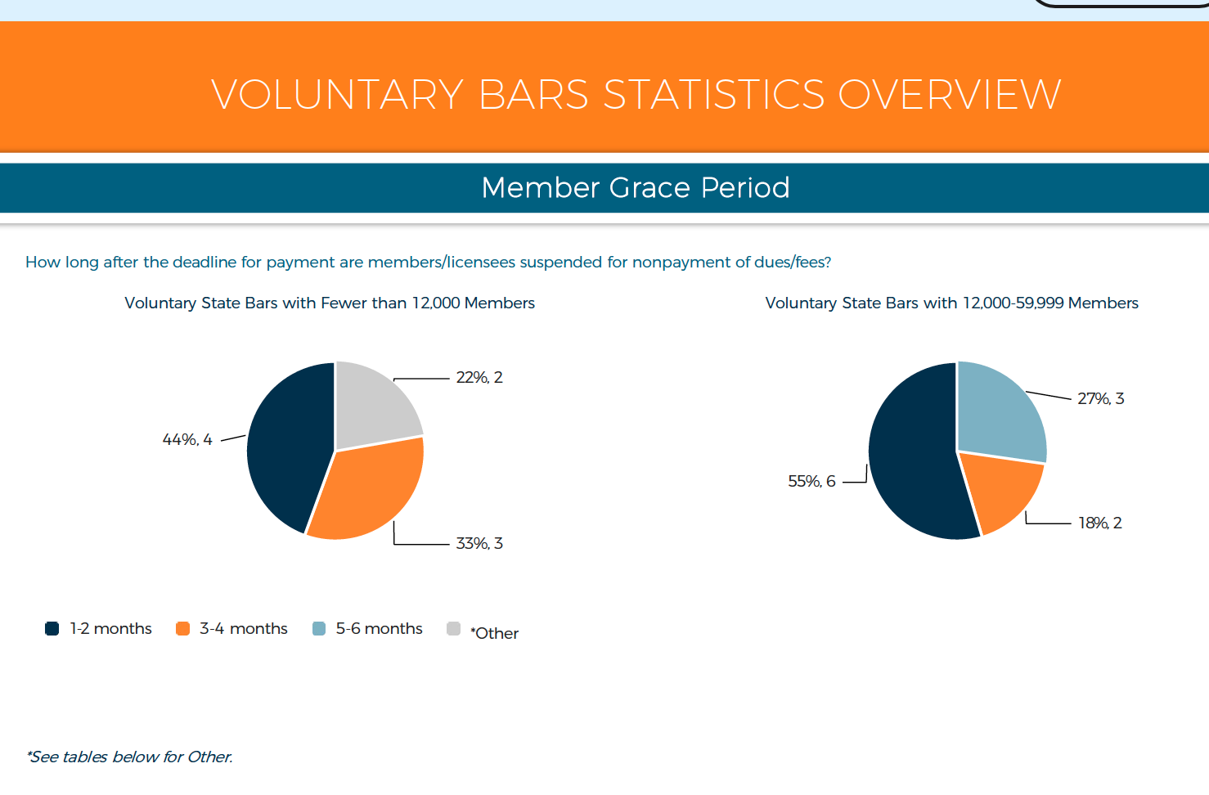

Slide 14

Lessons from
Bowling Alone
Social structures—whether they be PTA, local organizations, church, etc. help create a society that is happy, healthy, and safe.
How does the decline of those structures impact us and our institutions?
Life Stuff
Notes:
Published in 2000
Precient

Slide 15

What if they gave a program and nobody came?

Slide 16

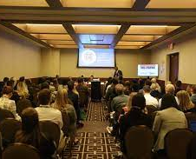

Meeting Angst

Slide 17
Social Shifts
Bar association as a convenor, problem-solver
Self-forming groups (local, metro)
Wellness (Deemphasizing alcohol at events)
Expectations of growth
In and out mentality (stickiness-streaming services)

Slide 18
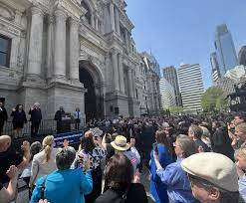
Rule of law and access to justice issues and their impact on the bar

Slide 19
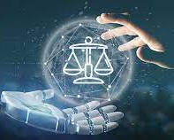
AI’s and Technology’s
Impact on the Legal Profession
&
The Work of the Association

Slide 20

AI and Access to Justice
How AI is Helping People Navigate the Justice System

Slide 21
AI Applications in the Justice System
Access to Legal Information:
• Chatbots and virtual assistants simplify legal jargon.
• Automated forms guide users through filings.
Navigation and Triage:
• Court guidance systems point to correct forms and services.
• AI triage directs people to self-help, mediation, or legal aid.
Language and Accessibility:
• AI translation tools for non-English speakers.
• Voice-enabled systems assist those with literacy challenges.
Research and Preparation:
• Summarization of case law and statutes.
• Predictive analytics on case outcomes.
Courtroom Support:
• Scheduling and text reminders reduce missed hearings.
• AI assists participants in virtual hearings.
Legal Aid Innovation:
• AI screens clients and drafts documents faster.
• Plain language summaries of court orders.
Challenges:
• Accuracy and reliability of AI advice.
• Equity in access to digital tools.
• Ethics and oversight to prevent misuse.

Slide 22

Internal Policies Regarding AI
Staff use
Disclosure
Copyright
Hiring
Responsibility
Training

